Slide 1
Module : Programmation Orientée objet
Université M’hamed Bougara Boumerdes
Département d’Informatique
2eme Année Licence
Développement Web & Infographie
Préparé par Si Salah H.
2021-2022

Slide 2
Introduction à la programmation orientée objet
  Classe /Objet
  Attributs/Méthodes
  Spécificateurs d’accès
  Getters/Setters
  Encapsulation/Interface
  Constructeurs/Destructeur

Slide 3
Traditional programming
In traditional programming:
  Programs are basically lists of instructions to the computer that
    define data (via variables).
    and then work with that data (via statements and functions).
  Data and the functions that work on that data are separate entities that are combined together to produce the desired result.

Slide 4
Take a look around you !
Everywhere you look are objects.
Objects have two major components to them:
  1) A list of relevant properties (e.g. weight, color, size, solidity, shape, etc),
  2) Some number of behaviors that they can exhibit (e.g. being opened, making something else hot, etc…).
These properties and behaviors are inseparable.

Slide 5
Traditional programming
With traditional programming, the properties (data) and behaviors (functions) are separate entities,
which means that traditional programming often does not provide a very intuitive representation of reality.
It’s up to the programmer to manage and connect the properties to the behaviors in an appropriate manner

Slide 6
Object Oriented Programming (OOP)
Object-oriented programming (OOP) provides us with the ability to design an “object”, which ties together both properties and behaviors into a self-contained, reusable package.
Objects also provide a more intuitive way to work with our data by allowing us to define how we interact with the objects, and how they interact with other objects.
OOP doesn’t replace traditional programming methods. Rather, it gives you additional tools in your programming tool belt to manage complexity when needed.

Slide 7
Structs
While C++ provides a number of fundamental data types (e.g. char, int, long, float, double, etc…) that are often sufficient for solving relatively simple problems, it can be difficult to solve complex problems using just these types
One of C++’s more useful features is the ability to define your own data types that better correspond to the problem being solved

Slide 8
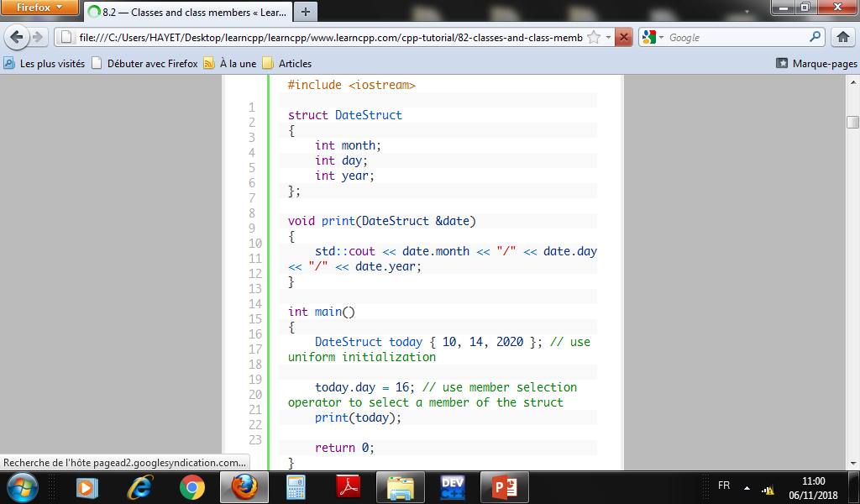
Example

Slide 9
Classes
In OOP, we often want our types to not only hold data, but provide functions that work with the data as well.
In C++, this is typically done via the class keyword.
Using the class keyword defines a new user-defined type called a class.

Slide 10
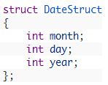
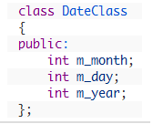
Classes vs structs
In C++, classes are very much like data-only structs, except that classes provide much more power and flexibility. In fact, the following struct and class are effectively identical:

Slide 11
Remarks
Just like a struct declaration, a class declaration does not declare any memory. It only defines what the class looks like.
Do not forget the semicolon at the end of a class declaration.

Slide 12

Object
In C++, when we define a variable of a class, we call it instantiating the class.
The variable itself is called an instance of the class. A variable of a class type is also called an object.
Instantiating a variable allocates memory for the object.

Slide 13
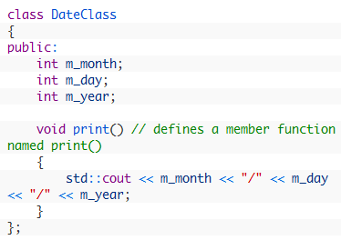
Member Functions
In addition to holding data, classes can also contain functions! Functions defined inside of a class are called member functions

Slide 14
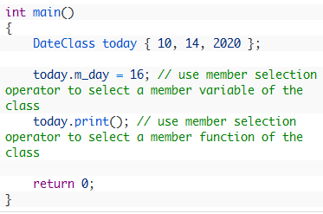
Accessing a members of a class
Just like members of a struct, members (variables and functions) of a class are accessed using the member selector operator (.)

Slide 15
Classes vs structs programs
In the struct version of print(), we needed to pass the struct itself to the print() function as the first parameter. Otherwise, print() wouldn’t know what DateStruct we wanted to work on.
However, in our class version of print(), we do not need to pass a DateClass to print()!
Because print() is being called on class variable “today”, the member variables in print() will refer to the member variables of class variable today!
Thus, inside the call to today.print(), m_day is actually referring to today.m_day.

Slide 16
Best practices rules
Using the “m_” prefix for member variables helps distinguish member variables from function parameters or local variables inside member functions.
This is useful for several raisons. Provide one!

Slide 17
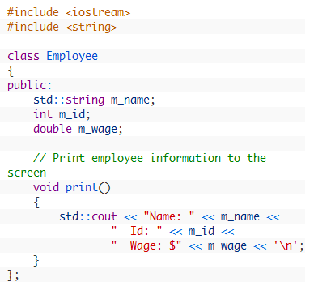
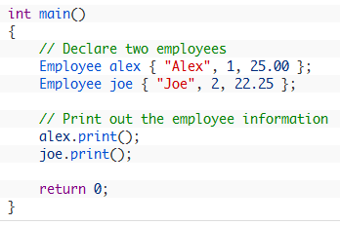
Best practices rules
By convention, class names should begin with an upper-case letter

Slide 18
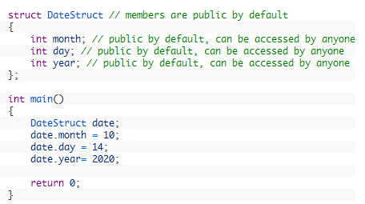
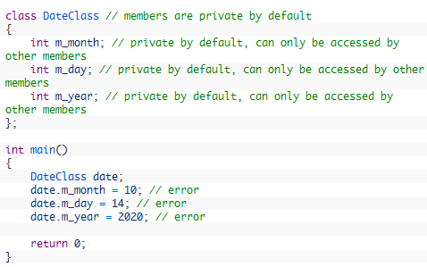
Public and private members
This works because all members of a struct are public members by default. Public members are members of a struct or class that can be accessed from outside of the struct or class
by default, all members of a class are private. Private members are members of a class that can only be accessed by other members of the class.

Slide 19
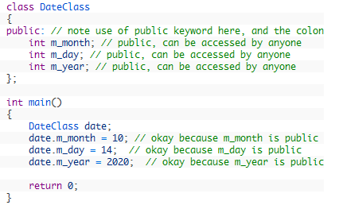
Example of public members

Slide 20
Access specifiers
The public keyword, along with the following colon, is called an access specifier.
Access specifiers determine who has access to the members that follow the specifier.
Each of the members “acquires” the access level of the previous access specifier (or, if none is provided, the default access specifier).

Slide 21
Types of access specifiers
C++ provides 3 different access specifier keywords: public, private, and protected.
Public and private are used to make the members that follow them public members or private members respectively.
The third access specifier, protected, works much like private does.

Slide 22
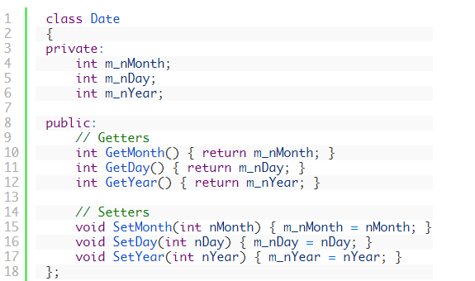
Access functions
An access function is a short public function whose job is to retrieve or change the value of a private member variable.

Slide 23
Public interface of a class
The group of public members of a class are often referred to as a public interface.
Because only public members can be accessed from outside of the class, the public interface defines how programs using the class will interface with the class.

Slide 24
Example
Interface of Date class

Slide 25
Encapsulation
Encapsulation is the idea of hiding the details of how something is implemented and instead exposing an interface to the user.
This allows the user to use the item without having to worry about how it is implemented

Slide 26
Encapsulation
Access specifies allow us to implement encapsulation within our classes.
This is typically done by making ALL member variables of a class private, and providing public functions (often access functions) that allow the user to work with the class.
This provides several very useful benefits that help encourage class reusability and maintainability.

Slide 27
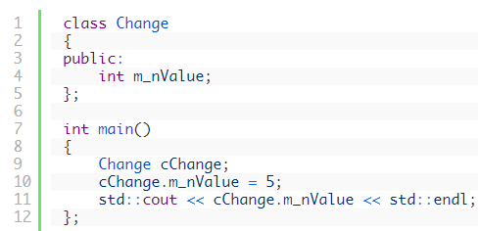
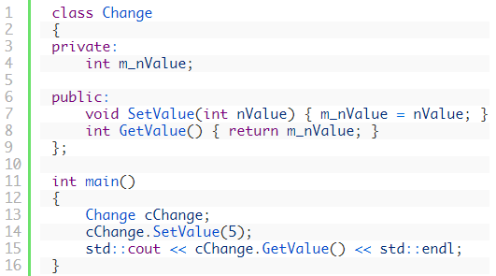
Example – Interest of encapsulation
Essayez de changer le nom de m_nValue dans les deux cas. Qu’est ce que vous remarquez?
Le changement doit se faire dans la classe et dans le main !
Le changement doit se faire uniquement dans la classe ! Car m_nValue est inaccessible directement de l’ extérieur de la classe !

Slide 28
Constructeurs et Destructeur

Slide 29
Constructor
A constructor is a special kind of class member function that is executed when an object of that class is instantiated.
Constructors are typically used to initialize member variables of the class to appropriate default values, or to allow the user to easily initialize those member variables to whatever values are desired.

Slide 30
Constructor
Unlike normal functions, constructors have specific rules for how they must be named:
  1) Constructors should always have the same name as the class (with the same capitalization)
  2) Constructors have no return type (not even void)
A constructor that takes no parameters (or has all optional parameters) is called a default constructor.

Slide 31
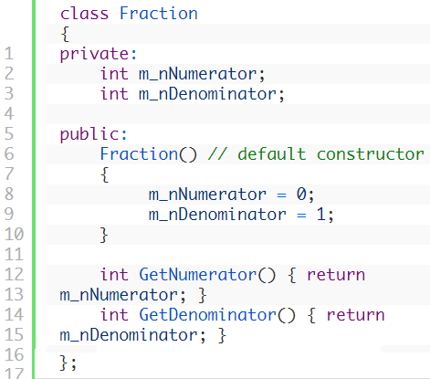
Example

Slide 32
Constructors with parameters
Constructors can also be declared with parameters

Slide 33
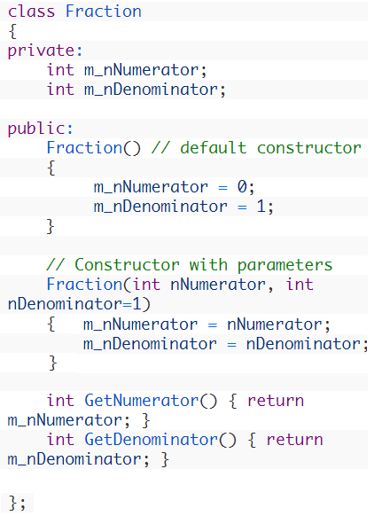


Example
2 constructors
Declaration

Slide 34
Quiz
What happens if we do not use a constructor in a class?

Slide 35
Destructor of a class
A destructor is another special kind of class member function that is executed when an object of that class is destroyed.
When a variable goes out of scope, or a dynamically allocated variable is explicitly deleted using the delete keyword, the class destructor is called (if it exists) to help clean up the class before it is removed from memory.

Slide 36
Destructor
For simple classes, a destructor is not needed because C++ will automatically clean up the memory for you.
However, if you have dynamically allocated memory, or if you need to do some kind of maintenance before the class is destroyed (eg. closing a file), the destructor is the perfect place to do so.

Slide 37
Destructor
Like constructors, destructors have specific naming rules:
1) The destructor must have the same name as the class, preceded by a tilde (~).
2) The destructor can not take arguments.
3) The destructor has no return type.

Slide 38
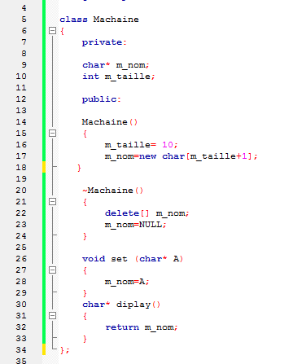

Example of destructor

Slide 39
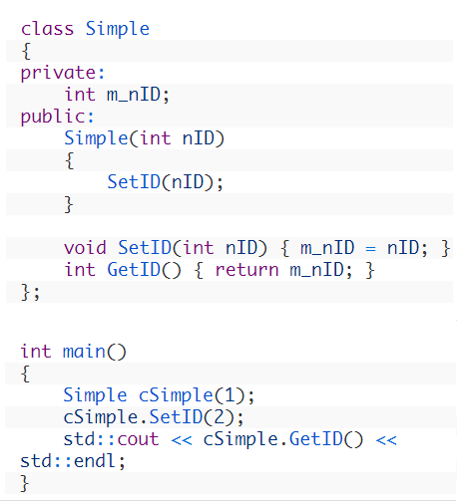
The hidden pointer « this »
What happens when we instanciate an object ?

Slide 40
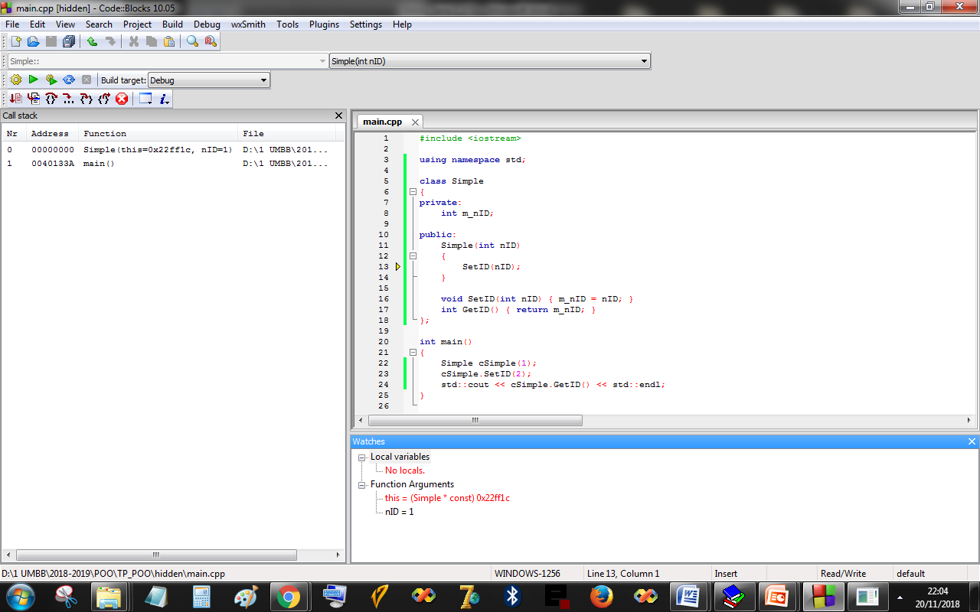
The hidden pointer « this »

Slide 41
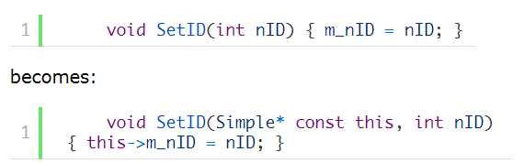
The hidden pointer « this »

Slide 42
Copy constructor
Used to initialize an object by copying from another existing object.
Example:
Void main()
{
Produit P1;
Produit P2 (P1) ;
……….
}
Creating an objet by calling a default constructor
Creating and initializing an object by copying from P1

Slide 43
Copy constructor
Class Produit
{ private :
int m_code, m_Prix, m_Poids ;
char * nom;
public:
Produit ();
Produit ( Produit& P) ;
}
Copy constructor, taking an object of Produit as argument passed by reference

Slide 44
Remark
A copy constructor is recommended when using classes that include one or more dynamic attribute (pointer)

Slide 45
Objets constants
Attributs et méthodes constantes
Les fonctions et classes amies

Slide 46
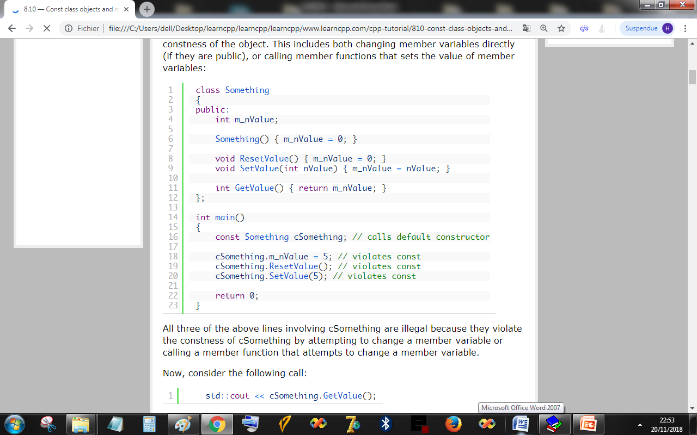
Constant objects

Slide 47
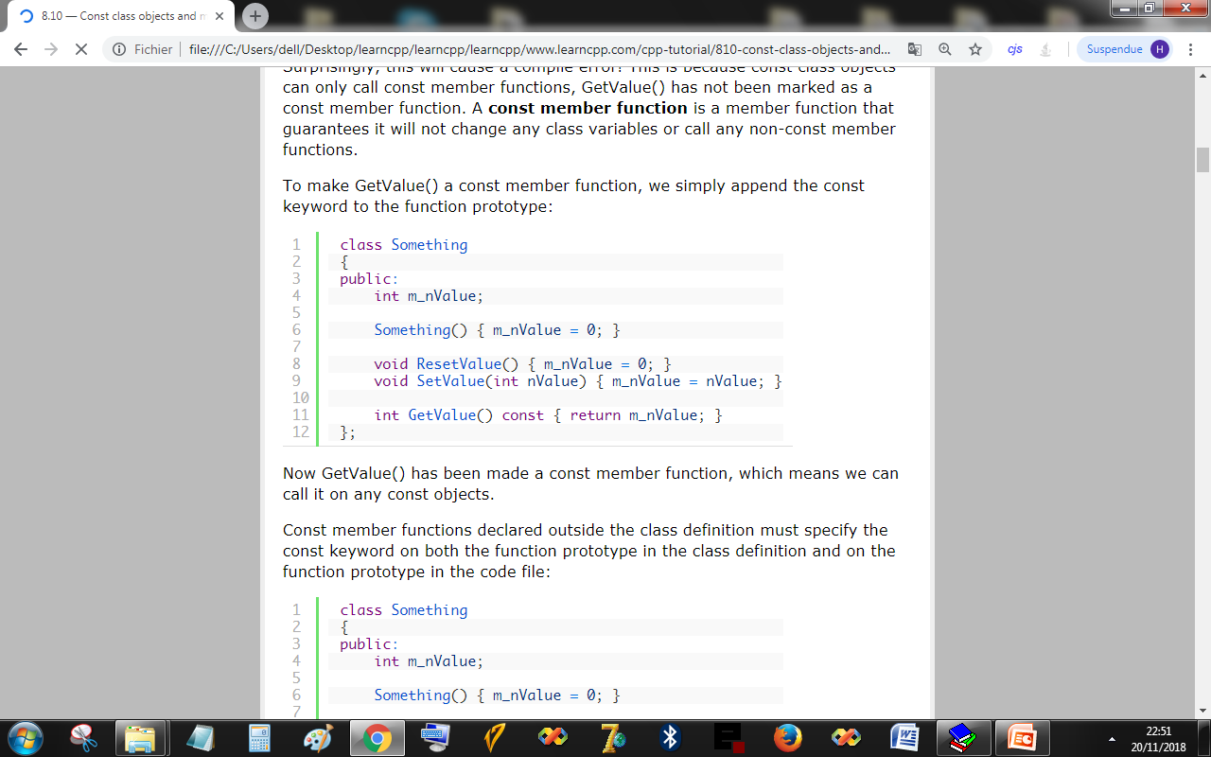
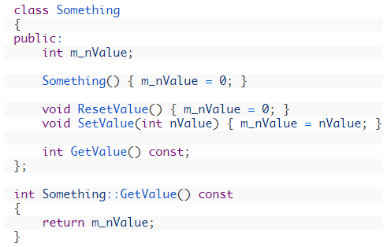
Constant object / constant method

Slide 48
Default arguments

Slide 49
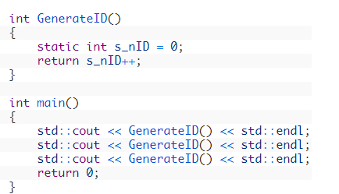
Static variable
What is the result of this program?
0
1
2

Slide 50
Static member variables (attributes)
A static member variable is shared between all objects of the class.
A static members belong to the class itself, not to the objects of the class.
A static member can be accessed directly using the class name and the scope operator “:”

Slide 51
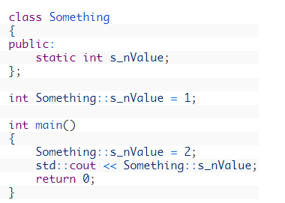
Static member variables
Call without using an object

Slide 52

Initializing static member variables
Because static member variables are not part of the individual objects, you must explicitly define the static member if you want to initialize it to a non-zero value
Example :
In the absense of an initializing line, C++ will initialize the value to 0.

Slide 53
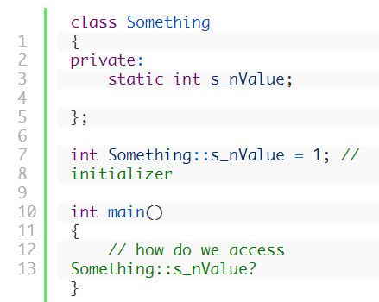
Static member functions
classes can have member variables that are shared across all objects of that class type. However, what if our static member variables are private?
Example:

Slide 54
Static member function
While we could create a normal public member function to access s_nValue, we need to instantiate an object of the class type to use the function!
We can do better: make member functions static.
Like static member variables, static member functions are not attached to any particular object

Slide 55
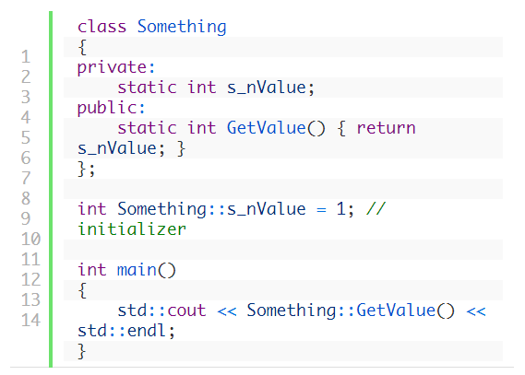
Example of a static member function

Slide 56
Static member functions- Remarks
Static member functions are not attached to an object, they have no ”this” pointer!
Static member functions can only access static member variables. They can not access non-static member variables.
Non-static member variables must belong to a class object, and static member functions have no class object to work with!

Slide 57
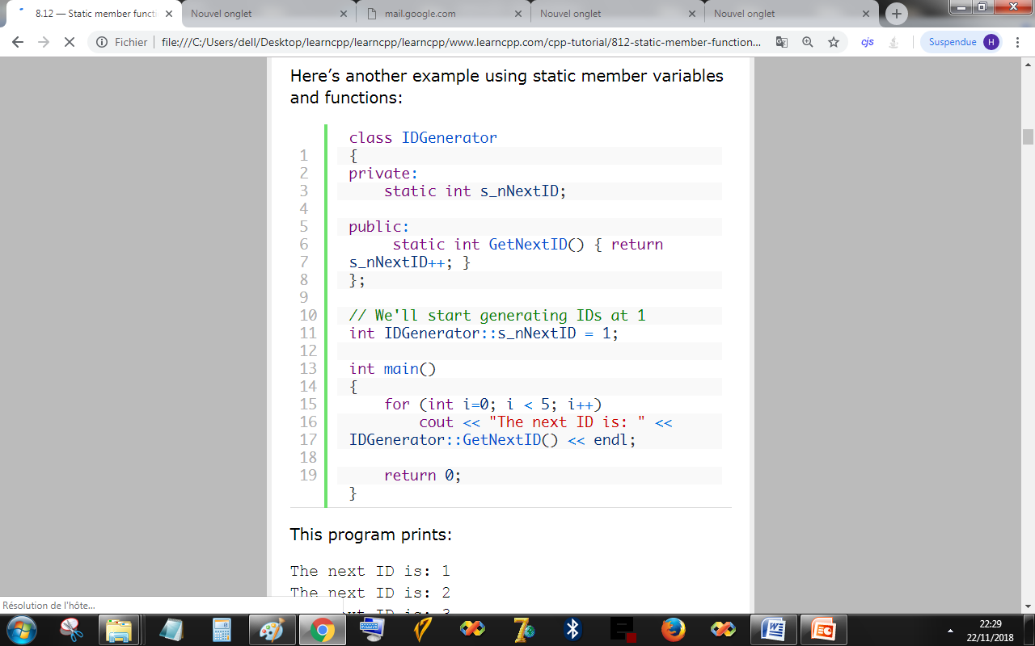
Another example

Slide 58
Friend functions
A friend function is a function that can access the private members of a class as though it were a member of that class.
A friend function may or may not be a member of another class.
To declare a friend function, simply use the friend keyword in front of the prototype of the function you wish to be a friend of the class.

Slide 59
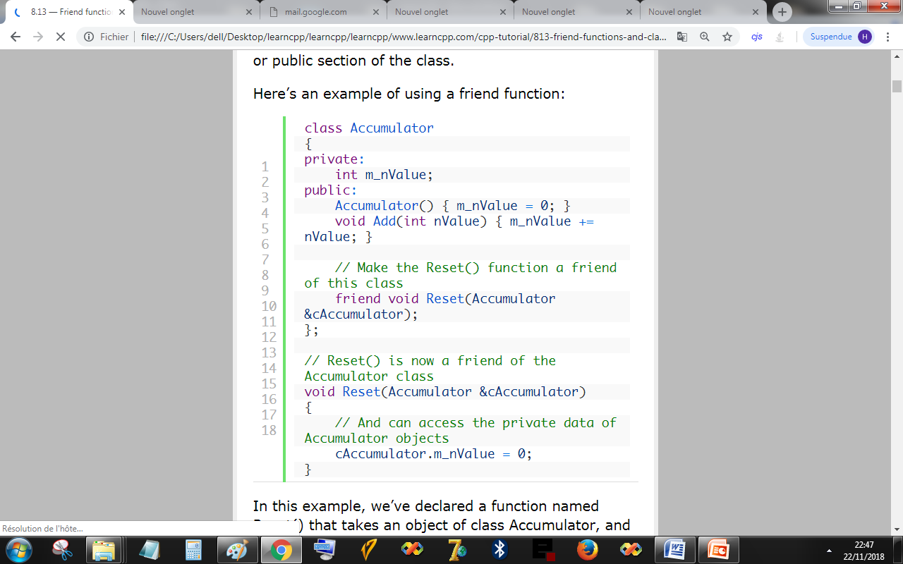
Example

Slide 60
Friend functions and classes
A function can be a friend of more than one class at the same time.
It is also possible to make an entire class a friend of another class. This gives all of the members of the friend class access to the private members of the other class.

Slide 61
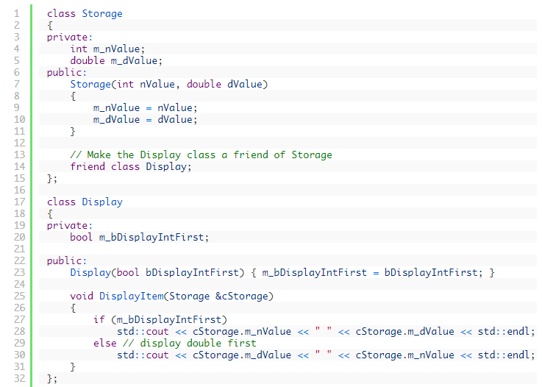
Example of a friend class

Slide 62
Remarks
Even though Display is a friend of Storage, Display has no direct access to the *this pointer of Storage objects.
because Display is a friend of Storage, that does not mean Storage is also a friend of Display!
If you want two classes to be friends of each other, both must declare the other as a friend.
If class A is a friend of B, and B is a friend of C, that does not mean A is a friend of C.

Slide 63
Remarks
Be careful when using friend functions and classes, because it allows the friend function or class to violate encapsulation.
If the details of the class change, the details of the friend will also be forced to change. Consequently, limit your use of friend functions and classes to a minimum.

Slide 64
L’héritage

Slide 65
Introduction to inheritance
Inheritance involves creating new objects by directly acquiring the attributes and behaviours of other objects and then extending or specializing them.
Inheritance is everywhere in real life.
  You inherited your parents genes, and acquired physical attributes from both of them.
  Technological products (computers, cell phones, etc…) often inherit features from their predecessors.
  C++ inherited many features from C language.
  ETC ETC ETC

Slide 66
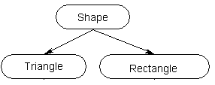
Terminology
The object being inherited from is called the parent or base,
and the object doing the inheriting is called the child or derived object.
parent / base
child / derived

Slide 67
Why using inheritance?
Inheritance allows you directly reuse existing code that meets your needs.
  You only need to add new features,
  redefine existing features that do not meet your needs,
  or hide features you do not want.

Slide 68
Inheritance in C++
Inheritance in C++ takes place between classes.
When one class inherits from another, the derived class inherits the variables and functions of the base class.
These variables and functions become part of the derived class.

Slide 69
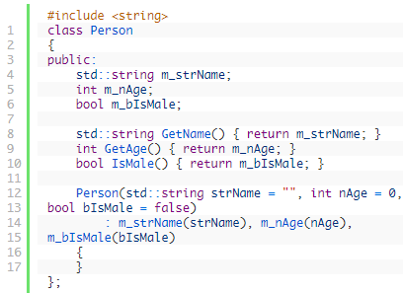
Example of a base class

Slide 70
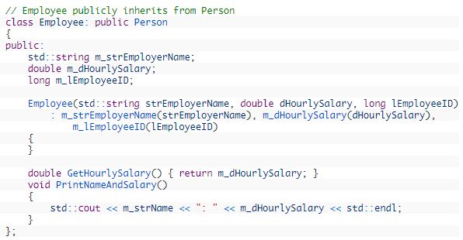
Example of its derived class

Slide 71

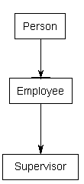
Inheritance chains

Slide 72
QUIZ
DONNEZ UN EXEMPLE D’UNE CLASSE QUI HERITE D’UNE AUTRE CLASSE

Slide 73
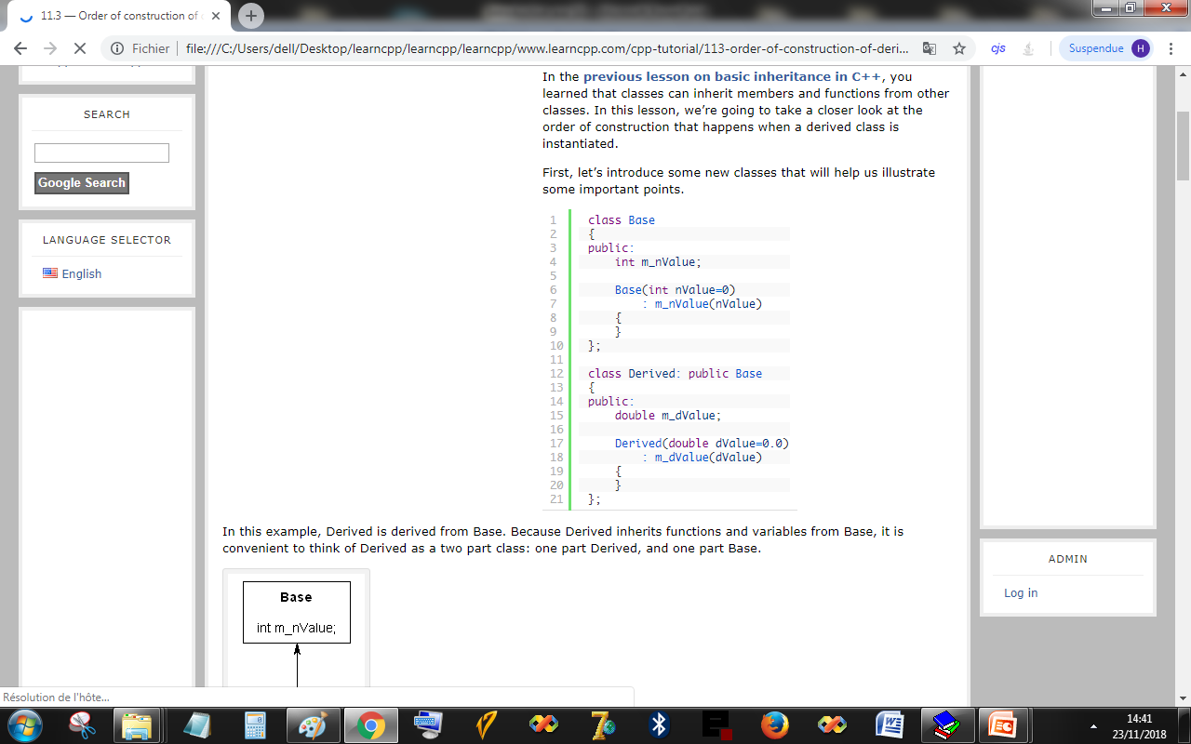
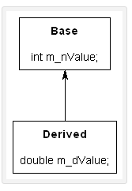
Order of construction of derived classes
the Base portion of Derived is constructed first. Once the Base portion is finished, the Derived portion is constructed.

Slide 74
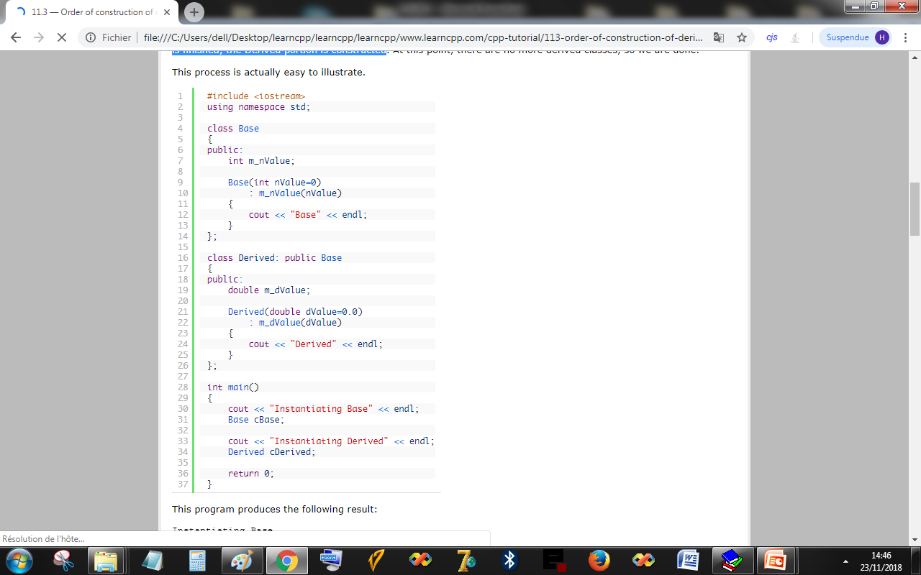
Example
What is the output of this program

Slide 75
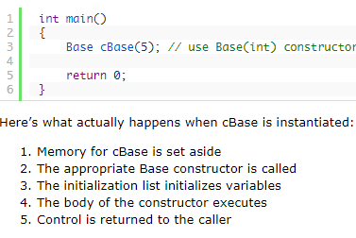
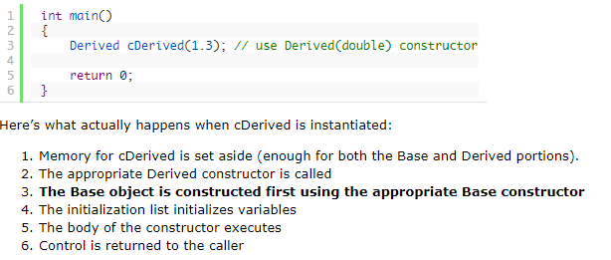
Constructors and initialization of derived classes
Memory for cBase is set aside
The appropriate Base constructor is called
The initialization list initializes variables
The body of the constructor executes
Control is returned to the caller
Memory for cDerived is set aside (enough for both the Base and Derived portions).
The appropriate Derived constructor is called
The Base object is constructed first using the appropriate Base constructor
The initialization list initializes variables
The body of the constructor executes
Control is returned to the caller
Notes:
Memory for cDerived is set aside (enough for both the Base and Derived portions).
The appropriate Derived constructor is called
The Base object is constructed first using the appropriate Base constructor
The initialization list initializes variables
The body of the constructor executes
Control is returned to the caller

Slide 76
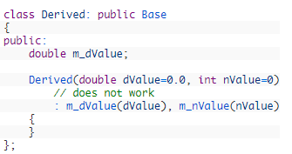
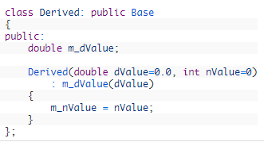
Initializing base class members
How to set both m_dValue (from the Derived portion of the object) and m_nValue (from the Base portion of the object) when we create a Derived object?

Slide 77
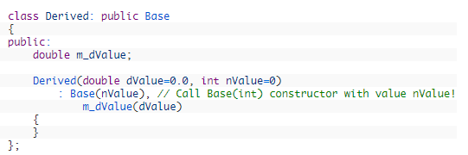
Initializing base class members
Fortunately, C++ gives us the ability to explicitly choose which Base class constructor will be called! To do this, simply add a call to the base class Constructor in the initialization list of the derived class:

Slide 78
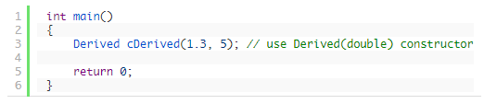
In more detail, here’s what happens:
Memory for cDerived is allocated.
The Derived(double, int) constructor is called, where dValue = 1.3, and nValue = 5
The compiler looks to see if we’ve asked for a particular Base class constructor. We have! So it calls Base(int) with nValue = 5.
The base class constructor initialization list sets m_nValue to 5
The base class constructor body executes
The base class constructor returns
The derived class constuctor initialization list sets m_dValue to 1.3
The derived class constructor body executes
The derived class constructor returns

Slide 79
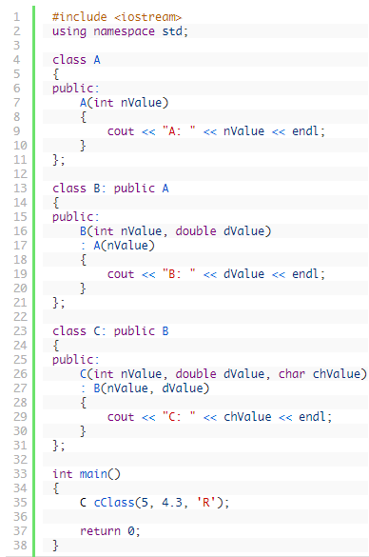
Inheritance chains
Explain how the object cClass is initialised?

Slide 80
Remarks
It is worth mentioning that constructors can only call constructors from their immediate parent/base class.
Consequently, the C constructor could not call or pass parameters to the A constructor directly.
The C constructor can only call the B constructor (which has the responsibility of calling the A constructor).

Slide 81
Destructors
When a derived class is destroyed, each destructor is called in the reverse order of construction.
In the above example, when cClass is destroyed, the C destructor is called first, then the B destructor, then the A destructor.

Slide 82
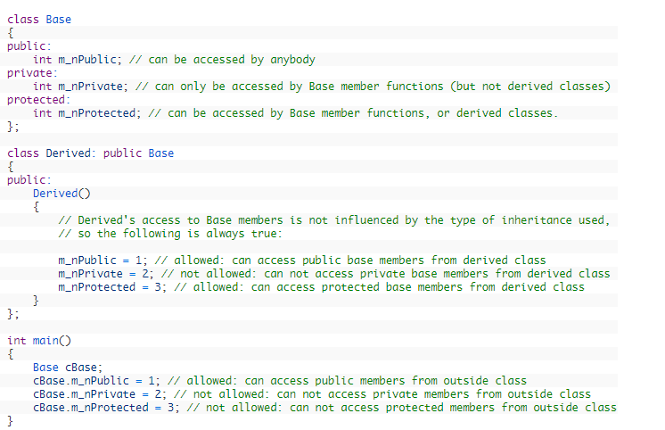
Inheritance and access specifiers

Slide 83
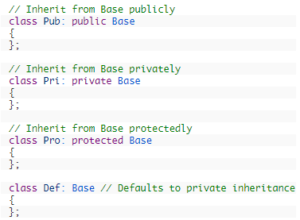
Inheritance and access specifiers
When a derived class inherits from a base class, the access specifiers may change depending on the method of inheritance.
There are three different ways for classes to inherit from other classes: public, private, and protected.

Slide 84
Keep in mind!
There are three ways that members can be accessed:
A class can always access it’s own members regardless of access specifier.
The public accesses the members of a class based on the access specifiers of that class.
A derived class accesses inherited members based on the access specifiers of its immediate parent.
A derived class can always access it’s own members regardless of access specifier.

Slide 85
Public inheritance
Public inheritance is by far the most commonly used type of inheritance.
Fortunately, public inheritance is also the easiest to understand.
When you inherit a base class publicly, all members keep their original access specifications. Private members stay private, protected members stay protected, and public members stay public.

Slide 86
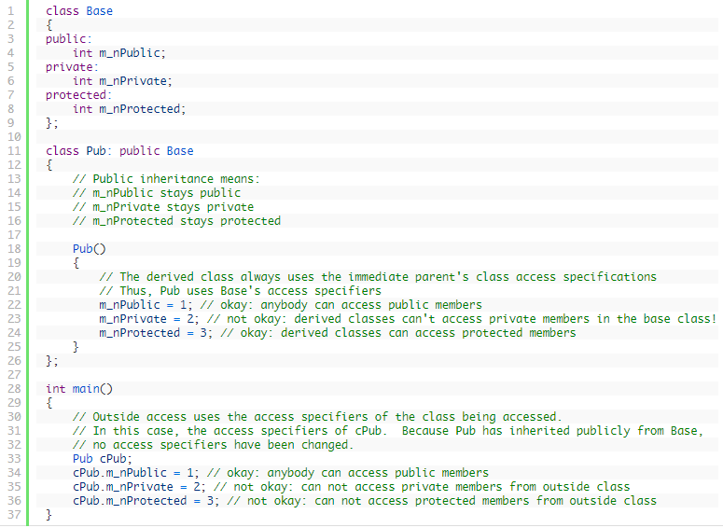
Public inheritance- Example

Slide 87

Remarks
The things worth noting are:
Derived classes can not directly access private members of the base class.
The protected access specifier allows derived classes to directly access members of the base class while not exposing those members to the public.
The derived class uses access specifiers from the base class.
The outside uses access specifiers from the derived class.

Slide 88
Private inheritance
With private inheritance, all members from the base class are inherited as private.
This means private members stay private, and protected and public members become private
This does not affect that way that the derived class accesses members inherited from its parent! It only affects the code trying to access those members through the derived class.

Slide 89
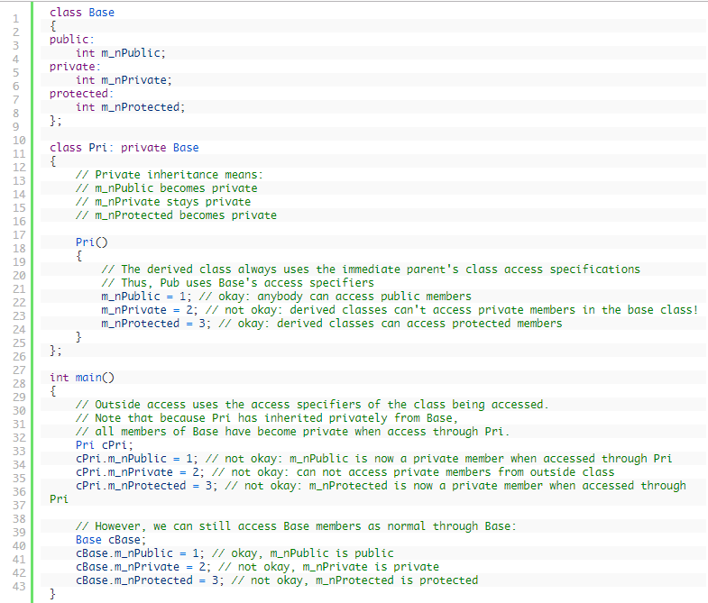
Private inheritance

Slide 90

Private inheritance –Summary

Slide 91

Protected inheritance
It is almost never used, except in very particular cases.
With protected inheritance, the public and protected members become protected, and private members stay private.

Slide 92
Summary
To clarify things as much as possible:
First, the base class sets it’s access specifiers. The base class can always access it’s own members. The access specifiers only affect whether outsiders and derived classes can access those members.
Second, derived classes have access to base class members based on the access specifiers of the immediate parent. The way a derived class accesses inherited members is not affected by the inheritance method used!
Finally, derived classes can change the access type of inherited members based on the inheritance method used. This does not affect the derived classes own members, which have their own access specifiers. It only affects whether outsiders and classes derived from the derived class can access those inherited members.

Slide 93
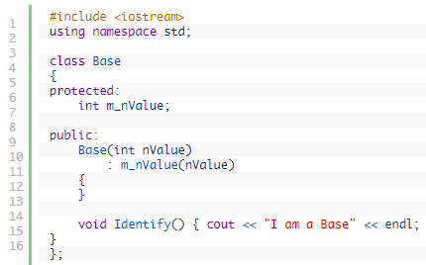
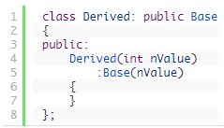
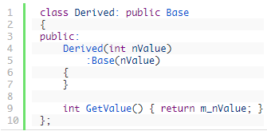
Adding new functionality in the derived class

Slide 94

Redefining functionality in derived class

Slide 95

Adding to existing functionality

Slide 96

Quiz: what is the output of main?

Slide 97
Hiding functionality
In C++, it is not possible to remove functionality from a class. However, it is possible to hide existing functionality.
  if you redefine a function, it uses whatever access specifier it’s declared under in the derived class.
  Therefore, we could redefine a public function as private in our derived class, and the public would lose access to it
C++ also gives us the ability to change a base member’s access specifier in the derived class without even redefining the member!

Slide 98



Example

Slide 99

Example

Slide 100

Multiple inheritance
C++ provides the ability to do multiple inheritance. Multiple inheritance enables a derived class to inherit members from more than one parent.
Example:

Slide 101


Example

Slide 102

Example (suite)

Slide 103

Problems with multiple inheritance
Ambiguity can result when multiple base classes contain a function with the same name.
The Diamond Problem:

Slide 104
Surcharge des méthodes et des operateurs

Slide 105


Function/Method overloading
Function overloading is a feature of C++ that allows us to create multiple functions with the same name, so long as they have different parameters.

Slide 106
Function/Method overloading
How function calls are matched with overloaded functions?
1) A match is found. The call is resolved to a particular overloaded function.
2) No match is found. The arguments can not be matched to any overloaded function.
3) An ambiguous match is found. The arguments matched more than one overloaded function.

Slide 107
When an overloaded function is called, C++ goes through the following process to determine which version of the function will be called
1)First, C++ tries to find an exact match. This is the case where the actual argument exactly matches the parameter type of one of the overloaded functions.
2) If no exact match is found, C++ tries to find a match through promotion.
3) If no promotion is found, C++ tries to find a match through standard conversion.
Finally, C++ tries to find a match through user-defined conversion.

Slide 108
First, C++ tries to find an exact match.
First, C++ tries to find an exact match. This is the case where the actual argument exactly matches the parameter type of one of the overloaded functions. For example:
This is the case where the actual argument exactly matches the parameter type of one of the overloaded functions.
Example:
1 2 3 4 | void print(char *value); void print(int value); print(0); // exact match with print(int)

Slide 109
If no exact match is found, C++ tries to find a match through promotion
EX:
  Char, unsigned char, and short is promoted to an int.
  Unsigned short can be promoted to int or unsigned int
  Float is promoted to double
  Enum is promoted to int
1 2 3 4 | void print(char *value); void print(int value); print('a'); // promoted to match print(int)

Slide 110
If no promotion is found, C++ tries to find a match through standard conversion.
  EX:
  Any numeric type will match any other numeric type, including unsigned (eg. int to float)
  Enum will match the formal type of a numeric type (eg. enum to float)
  Zero will match a pointer type and numeric type (eg. 0 to char*, or 0 to float)
  A pointer will match a void pointer
1 2 3 4 5 | struct Employee; // defined somewhere else void print(float value); void print(Employee value); print('a'); // 'a' converted to match print(float)

Slide 111
Finally, C++ tries to find a match through user-defined conversion
classes (which are similar to structs) can define conversions to other types that can be implicitly applied to objects of that class.
Example:
1 2 3 4 5 6 7 | class X; // with user-defined conversion to int void print(float value); void print(int value); X value; // declare a variable named cValue of type class X print(value); // value will be converted to an int and matched to print(int)

Slide 112

Operator overloading -Example

Slide 113

Operator overloading –Example2

Slide 114
Overloading operators for operands of different types
Often it is the case that you want your overloaded operators to work with operands that are different types. For example, if we have Cents(4), we may want to add the integer 6 to this to produce the result Cents(10).
When C++ evaluates the expression x + y, x becomes the first parameter, and y becomes the second parameter. When x and y have the same type, it does not matter if you add x + y or y + x -- either way, the same version of operator+ gets called. However, when the operands have different types, x + y is not the same as y + x.

Slide 115

Operator overloading –Example3

Slide 116
Polymorphisme

Slide 117
Exceptions
Exception handling provides a mechanism to decouple handling of errors or other exceptional circumstances from the typical control flow of your code. This allows more freedom to handle errors when and however is most useful for a given situation
Exceptions in C++ are implemented using three keywords that work in conjunction with each other: throw, try, and catch.

Slide 118
throw statement
In C++, a throw statement is used to signal that an exception or error case has occurred. Signaling that an exception has occurred is also commonly called raising an exception.
To use a throw statement, simply use the throw keyword, followed by a value of any data type you wish to use to signal that an error has occurred.
Typically, this value will be an error code, a description of the problem, or a custom exception class.

Slide 119
Examples:
1 2 3 4 5 | throw -1; // throw a literal integer value throw ENUM_INVALID_INDEX; // throw an enum value throw "Can not take square root of negative number"; // throw a literal char* string throw dX; // throw a double variable that was previously defined throw MyException("Fatal Error"); // Throw an object of class MyException

Slide 120
Looking for exceptions
Throwing exceptions is only one part of the exception handling process.
In C++, we use the try keyword to define a block of statements (called a try block). The try block acts as an observer, looking for any exceptions that are thrown by statements within the try block.
1 2 3 4 5 | try { // Statements that may throw exceptions you want to handle now go here throw -1; }

Slide 121
Handling exceptions
Actually handling exceptions is the job of the catch block(s). The catch keyword is used to define a block of code (called a catch block) that handles exceptions for a single data type.
1 2 3 4 5 | catch (int) { // Handle an exception of type int here cout << "We caught an exception of type int" << endl; }

Slide 122
Remarks
Try blocks and catch blocks work together -- A try block detects any exceptions that are thrown by statements within the try block, and routes them to the appropriate catch block for handling.
A try block must have at least one catch block attached to it, but may have multiple catch blocks listed in sequence

Slide 123
Example
1 2 3 4 5 6 7 8 9 10 11 12 13 14 15 16 17 18 19 20 | int main() { try { // Statements that may throw exceptions you want to handle now go here throw -1; } catch (int) { // Any exceptions of type int thrown within the above try block get sent here cerr << "We caught an exception of type int" << endl; } catch (double) { // Any exceptions of type double thrown within the above try block get sent here cerr << "We caught an exception of type double" << endl; } return 0; }

Slide 124
How exceptions work
When an exception is raised (using throw), execution of the program immediately jumps to the nearest enclosing try block.
If any of the catch handlers attached to the try block handle that type of exception, that handler is executed and the exception is considered handled.
If no appropriate catch handlers exist, execution of the program propagates to the next enclosing try block.
If no appropriate catch handlers can be found before the end of the program, the program will fail with an exception error.

Slide 125
Example
1 2 3 4 5 6 7 8 9 10 11 12 | int main() { try { throw 4.5; // throw exception of type double cout << "This never prints" << endl; } catch(double dX) // handle exception of type double { cerr << "We caught a double of value: " << dX << endl; } }

Slide 126
How to write a good class

